Slide 1
Question 5: Is mental health severity lower in the US?
Null Hypothesis - There is no statistically significant difference in median severity factor between US and non-US populations
Alternative Hypothesis - The median derived severity factor is less in the US than in countries outside the US, at an ɑ = 0.05.
A one-sided Mann-Whitney U-test was performed due to the low p-value of the normality test. An additional one-sided t-test was performed despite nonnormality, due to large sample sizes.

Slide 2
Question 5: US vs. Non-US Mental Health Definition of severity, data pre-processing
Evaluating mental_health_severity - defined as the sum of the selected factors below, after numerical mapping applied to columns -
growing_stress, changes_habits, mental_health_history, mood_swings, coping_struggles, work_interest, social_weakness
Analysis started with df_factors.csv, after -
numerical mapping applied to categorical variables based on evaluated severity
3 additional derived factors based on numerical mapping, using relevant columns, one of which was mental_health_severity

Slide 3
Question 5: US vs. Non-US Mental Health Data pre-processing (cont.)
The average severity score for each unique country was calculated by totaling the counts of each possible factor value in a weighted manner.
Weights for each value in the range [ -6 , 6 ] were established using total # of measurements per country as the denominator.
Of the 35 countries tested, Belgium and Poland had the highest mean derived severity factor at 6.103155. However, the # of measurements made in these countries was relatively low in comparison to countries with much more data like the US, UK, and Canada.

Slide 4
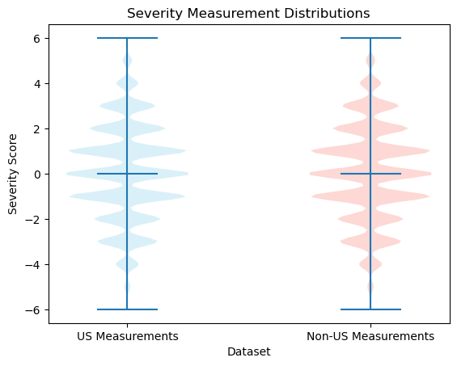
Question 5: US vs. Non-US Mental Health Violin plots of discrete data
The multiple violin plot shows the relative symmetry of the distributions, centered around 0.
The plots show very similar, nearly-normal shapes despite their failure of the normality tests.
The similar shapes of distribution mean the Mann-Whitney test will be testing for difference in pop. median

Slide 5
Question 5: US vs. Non-US Mental Health Normality tests
Both US and non-US populations failed the normality tests using scipy.stats.normaltest(). The low p-values for both populations suggests the underlying populations are not normally distributed.
US: test statistic = 776.82465918, p-value = 2.0638045e-169
Non-US - test statistic = 526.23257721, p-value = 5.37090858e-115
This suggests the inability to use many parametric statistical comparison tests in the comparison of this derived metric between US and non-US populations. However, due to the large sample sizes this limitation is ignored.

Slide 6
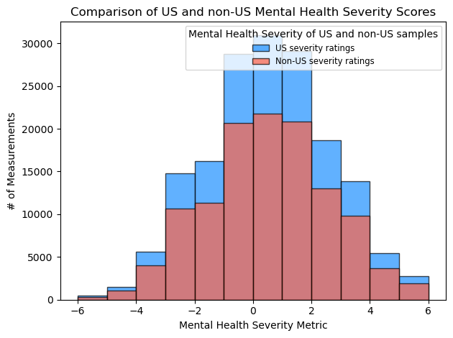
Question 5: US vs. Non-US Mental Health One-sided Mann-Whitney
A one-sided Mann-Whitney U-test was chosen due to -
the derived nature of the dependent variable (factor), as a composition of other underlying distributions
independence of both populations and observations
suggested non-normality of the underlying populations
the similar shape in distributions

Slide 7
Question 5: US vs. Non-US Mental Health One-sided Mann-Whitney U-test (cont.)
The Mann-Whitney test resulted in a p-value exceeding our a = 0.05 threshold. This means we fail to reject the null hypothesis, and conclude there is no statistically significant difference between median severity scores between US and non-US populations.
Test-statistic = 10042512229.5
P-value = 0.9431702048590704 > 0.05
Despite the inferred non-normality of the underlying distributions, a one-sided two-sample t-test was also conducted to check for a difference in mean, due to Central Limit Theorem.

Slide 8
Question 5: US vs. Non-US Mental Health One-sided two-sample t-test
The one-sided t-test resulted in a p-value exceeding our ɑ = 0.05 threshold. Although this test wasn’t initially chosen despite the non-normality and non-random samples, it was still performed due to the large sample sizes and the Central Limit Theorem.
Test-statistic = 1.6936521489831322
P-value = 0.9548337566013506 > 0.05
Since the p-value of the t-test exceeds 0.05, we fail to reject the null hypothesis and infer that there is no statistically significant indication that the mean severity of the US population is less than that of countries outside the US.

Slide 9
Question 5: US vs. Non-US Mental Health Results and Improvements
The non-normality of the underlying distributions of our derived mental health severity factor promoted the use of a nonparametric test. However, due to the large sample sizes, a parametric test was also performed. Both tests were performed at 95% confidence, with ɑ = 0.05.
Mann-Whitney U-test - No significant indication that median severity of mental health is lower in the United States.
Two-sample t-test - No significant indication that mean mental health severity is lower in the United States.
Neither test revealed a lower average mental health score in the US than in countries outside the US. Limitations of this analysis include -
The initial data may not have been collected randomly (voluntary survey data)
The factor analyzed was a linear combination of existing factors, whose underlying distributions were not known
Countries like the US, UK, and Canada had much larger datasets than the other 32 countries
Nonparametric statistics can limit the conclusions drawn from results

